Slide 1
Unit 5
Why do you like pandas?
Section B 2a-2c
七年级(下)

Slide 2

Objectives
To learn the situation of elephant
To learn the abilities of elephant
To learn to write the description of animals using adjectives of quality

Slide 3

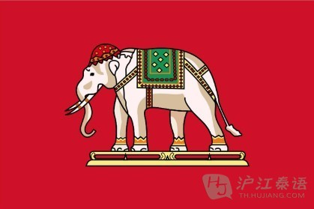
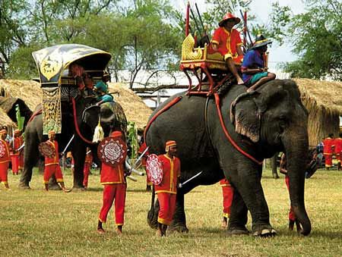
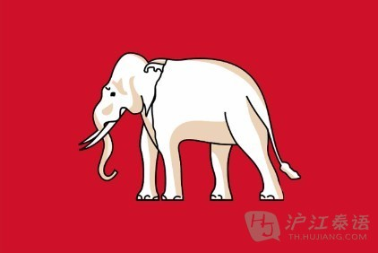
1. Importance in Thailand:
The elephant is one of Thailand’s symbols. The first flag has a white elephant on it.
This is a symbol of good luck.

Slide 4
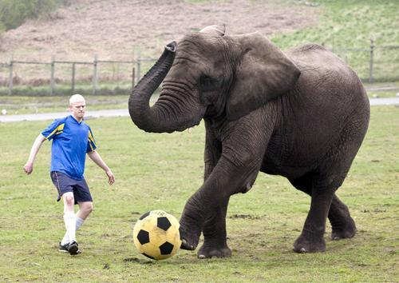
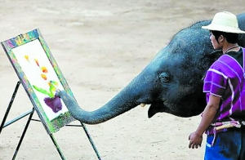
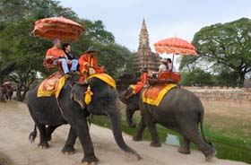
Ability:
Elephants can play soccer. They can also draw very well. An elephant never forgets. They can walk for a long time and never get lost. They can also remember places with food and water.

Slide 5
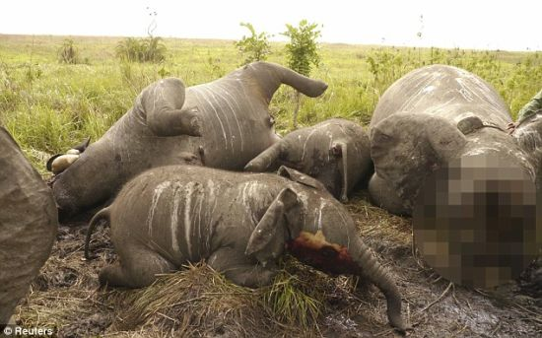
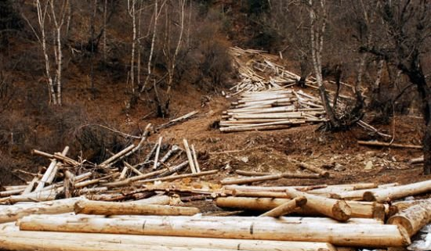
Facts:
Elephants are in great danger. People cut down many trees so elephants are losing their home. People also kill elephants for their ivory.

Slide 6


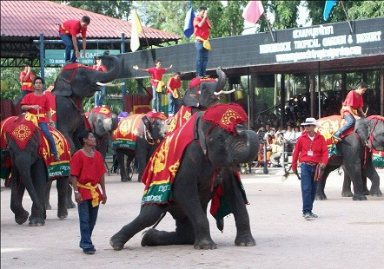
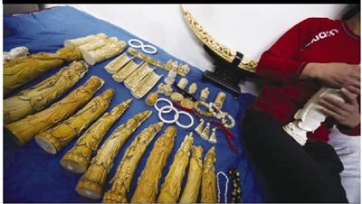
How to save elephants:
We must save the trees and not buy things made of ivory. Remember March 13th is Thai Elephant Day.

Slide 7
2a. Check (√) the animals you think
are in great danger.
_________ lions __________ elephants
_________ pandas __________ giraffes
_________ koalas __________ tigers
√
√
√

Slide 8


2b Read this website article and check (√) the best title for it.
What is an Elephant?
Come to Thailand
Let’s Save the Elephants
Elephants Are Good Pets
√

Slide 9


Hello. We are students from Thailand, and we want to save the elephants. The elephant is one of Thailand's symbols. Our first flag had a white elephant on it. This is a symbol of good luck.

Slide 10
Elephants are smart animals. They can
play soccer or music. They can also draw
very well. People say that “an elephant
never forgets”. Elephants can walk for
a long time and never get lost. They can
also remember places with food and water.
This helps them to live.

Slide 11
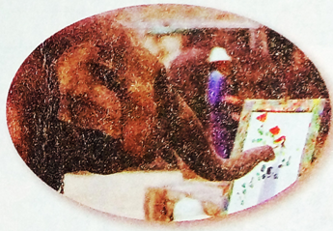
But elephants are in great danger. People cut down many trees so elephants are losing their homes. People also kill elephants for their ivory. Today there are only about 3,000 elephants (over 100,000 before). We must save the trees and not buy things made of ivory. Remember that March 13th is Thai Elephant Day.

Slide 12

Read the article again then answer the questions below.
Where are the students from?
_________________________
2. Are elephants smart animals?
__________________________
They’re from Thailand.
Yes, they are.

Slide 13
3. Why are elephants in great danger? ________________________________ ________________________________
4. When is Thai Elephant Day? ________________________________
Because people cut down many trees and they kill elephants for their ivory.
It’s on March 13th.

Slide 14

2c Read the article again and complete the mind map.
Importance in Thailand
first flag had ____________________
symbol of ________
a white elephant on it
good luck
Facts and figures
people ________ many trees
people kill them for _____
today there are _____ (over _______
before)
ELEPHANTS
cut down
ivory
3000
100,000

Slide 15
Abilities
can play _______________
can also _________ well
can _________ places with food and water
soccer or music
draw
remember
How to save them
don’t cut down too many ______
don’t _____ things made of ivory.
___________ is Thai Elephant Day.
trees
buy
Mar. 13th

Slide 16
Language points
1. one of + 名词复数形式 意为“……之一”
Jack is one of my friends. 杰克是我的朋友之一。
【注意】当“one of + 名词复数形式”作主语 时，当作整体看，用单数。
One of the lions is from Africa.
狮子中的一只是来自非洲。

Slide 17
2. get lost 迷途；迷路
The little girl can’t find her home. She gets lost. 小女孩找不到家了，她迷路了。
3. be in (great) danger 处于（极大）危险之中。
The boy falls into the lake. He’s in
great danger.
小男孩落入湖中, 他处于极大危险中。

Slide 18
4. cut down 砍伐
Don’t cut down trees. 不要砍伐树木。
5. over （数量）超过； 在……之上
Over one hundred people are in the library.
有超过一百人在图书馆里。
There’s a small bridge over the river.
在河上面有一座小桥。

Slide 19

1. 我们挽救五十多只猫。
We saved ____ fifty _____.
2. 狗是我所喜欢的动物之一。
Dogs are ____ of my favorite _______.
3. 长城是中国的象征。
The Great Wall is a _______ of ______.
over cats
one animals
symbol China

Slide 20
4. 一头大象能走很远的路且不会迷路。
An elephant can walk ___ a long ____ and _____ ____ ____.
5. 扬子鳄处于极度危险之中。
Yangtze crocodiles ___ __ _____ ______.
for way
never gets lost
are in great danger

Slide 21
选词填空。
flag, kill, place, save, cut down, over, forget, symbol
1. Mr. Lin jumped into the river to ____
the boy.
2. The British ____ is in red, white and blue.
3. The letter “V” is a ______ of victory
(胜利).
4. Don’t ____ wild animals.
They’re our friends.
save
flag
symbol
kill

Slide 22
5. They have to _________ the apple tree.
6. ━ Don’t ______ to take your schoolbags home.
━ OK, Mr. Brown.
7. _____ six hundred students go to school by bike.
8. A park is a good _____ for fun.
cut down
forget
Over
place

Slide 23
用所给单词的适当形式填空。
The people there are _______ (friend)
to us.
2. There is some _____ (water) in the cup.
3. Math is one of my favorite _______ (subject) at school.
4. Can you teach me how ________(play) the violin?
5. Let’s ___ (see) the koalas. They’re really cute.
friendly
water
subjects
to play
see

Slide 24
将下列短语翻译成英语。
1. 处于危险之中 ___________
2. 砍倒 ________________
3. 迷路 ________________
4. 来自 ________________
5. 由……制成 ____________
in danger
cut down
get lost
be from
be made of

Slide 25
使用上题中适当的短语并用其正确形式完成句子。
Take a map with you, or (否则) you’ll
_______ in the city.
2. These pandas are ________. Let’s help
them!
3. Koalas ________ Australia. They live in
the tree.
4. The table _________ wood (木头).
5. Don’t ________ the trees. They’re good
for us.
get lost
in danger
are from
is made of
cut down

Slide 26

1. 熟读2b中的短文。
2. 试着复述2b课文。

Slide 27
Thank You!

